Slide 1

Umesh Sinha
Senior Deputy Election Commissioner
Crossing the Barriers:
Making Elections Friendly and Accessible for Persons with Disabilities in India

Slide 2
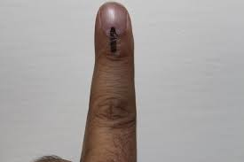
Making the right real
  All eligible citizens of India over the age of 18 have a right to vote regardless their disabilities

Slide 3
Major Challenges for PwDs
Registration
Information
Facilitation
Motivation
Voting at Polling Station

Slide 4
Major barriers encountered by persons with disabilities
Access to voter registration difficult
Lack of inadequate or inaccessible voter education or registration materials
Physical access to polling stations difficult
Cannot vote independently and privately
Inappropriate assistance from poll workers
Barriers can dissuade persons with disabilities from voting.
Technology can help improve access to the voting process.

Slide 5
Current Situation and Challenges for PwD Voters in India
According to Census 2011, the people with disabilities constitute 2.21% of the total population. However, many believe the number to be much larger.
60% of them can be estimated as voters (>18 years of age).
Although many provisions for people with disabilities do exist, participation of all registered voters in the category of PwD remains a challenge.
This is largely due to the many barriers such as inaccessibility, lack of infrastructure, lack of sensitized and aware polling personnel and education and motivation of the Voter.
Traditionally ‘disability’ was seen as a reason for exclusion but now ‘inadequate accommodation’ is considered the reason, making our role very important.

Slide 6

Proportion of Disabled Population
India and States/UTs : 2011
Source: C-Series, Table C-20, Census of India 2001 and 2011

Slide 7
National Policy For Persons With Disabilities
Barrier-free environment - for creation of barrier-free environment, the following strategies will be adopted:
1. Public buildings (functional or recreational), transport amenities including roads, sub-ways and pavements, railway platforms, bus-stops / terminals, ports, airports, modes of transports (bus, train, plane and waterways), playgrounds, open space etc. will be made accessible.
2. Use of sign language in all public functions will be encouraged.
3. Modification of Curriculum of Architects and Civil engineers will be undertaken to include issues relating to construction of barrier-free buildings. In service training will be provided on these issues to the government architects and engineers.
4. Full adoption of comprehensive building byelaws and space standards for barrier-free built environment shall be ensured. Effort will be made to ensure adoption of the byelaws and space standards by all the states, municipal bodies and Panchayati Raj institutions in the country. These authorities will ensure that all newly constructed buildings for public use are barrier-free.

Slide 8
State Transport Undertakings will ensure disabled friendly features in their vehicles. Railways will provide barrier-free coaches in a phased manner. They will also make the platforms-buildings, toilets and other facilities barrier-free.
The Government will ensure that Industrial establishments, offices, public utilities both in public and private sector provide disabled friendly work place for their employees. Safety standards will be developed and strictly enforced.
Proactive steps will be taken to ensure disability-friendly IT environment in the country.
All the buildings, which are for public use, will be audited for its accessibility to persons with disability. There may be a need to develop professionally recognized access auditors whose services would be utilized for the purpose.
Banking system will be encouraged to meet the needs to the persons with disabilities.
Communication needs of the persons with disabilities will be met by making information service and public documents accessible. Braille, tape-service, large print and other appropriate technologies will be used to provide information for the persons with visual disability.

Slide 9
Safeguards provided in the Constitution of India
Article 326
Elections to the House of the People and to the Legislative Assembly of every State shall be on the basis of adult suffrage;
Every citizen of India not less than eighteen years of age on such date as may be fixed in that behalf by law and is not otherwise disqualified... shall be entitled to be registered as a voter at any such election

Slide 10
Existing Provisions For Voters with Disabilities
Provisions under Rule 49N of the Conduct of Election Rules, 1961, ECI guidelines, and Supreme Court orders directly address the issue of assistance to people with disabilities.
Under Rule 49N, if owing to blindness or other physical infirmities an elector is unable to recognise the symbol on the EVM or unable to record vote by pressing the appropriate button thereon, the presiding officer shall permit the elector to take with him a companion of not less than eighteen years of age to the voting compartment for recording the vote on his behalf and in accordance with his wishes.
Physically challenged electors are required to be given priority for entering the polling station, without having to wait in the queue.

Slide 11
Existing Provisions
Polling personnel are to be given appropriate directions and sensitized through training classes about the special needs of the disabled and to be courteous and to provide necessary support to them at the polling station.
Permanent ramps to be provided in all public buildings where polling stations are located. Full facility should be provided for such electors to take their wheelchair inside the polling station. Where permanent ramps have not been provided, temporary ramps have to be provided.
Sufficient publicity to be given well in advance in print and electronic media about the availability of facilities so that the persons with disabilities are aware of the facilities before hand, and are thus encouraged to go and exercise their franchise.
Observers should also satisfy that such facilities are given; the absence of such facilities should be notified to the respective Government for remedial/future action.

Slide 12
ECI with PwDs
PwDs have the right to full political participation & equality & not be discriminated against on any grounds – ECI.
Opportunity to be involved in political life is at the heart of what it means to live in a democratic society.
Accessible & enabling environment of election is an opportune moment to be engaged in political life.
Electoral & Political rights of PwDs is respected, protected & promoted by ECI.
Provides accessible information & processes, better support, infrastructure & provisions throughout the electoral cycle.
Committed to ensure that PwDs enjoy their rights equally, & when required, improve further with changing times to enable better participation.

Slide 13
Measures & Provisions by ECI –
Registration of Voters
During the Lok Sabha Election 2014, ECI initiated several measures that made registration process voter-friendly.
  Online registration & name search facility in Electoral Roll on ECI’s & CEOs’ website.
  SMS based services for searching name and polling booth.
  Information on election laws, guidelines & details regarding ROs, AROs, BLOs on CEOs’ website.
  Voter Facilitation Centres (VFCs) for E-Roll issues & EPIC.
  Forms 6, 7, 8 & 8A at prominent places including banks, post offices, colleges, universities & schools.
  Nation-wide Special registration camps held in weekly haats, during festivals & through mobile vans to facilitate voters for checking their details on the voters’ list.
Notes:
endeavor - to identify gaps & formulate interventions based on the findings -

Slide 14
Measures & Provisions by ECI –
Poll Day
ECI implemented several measures to ensure basic facilities at the polling stations making them conducive for PwDs to cast their vote
  Braille signage on the Ballot Unit of EVM
  Construction of ramps – temporary installed where permanent ramps had not been provided.
  Entering polling stations without waiting in the queue.
  Facility granted to take wheel chairs inside polling stations.
  Polling personnel briefed about the provisions of Rule 49 N of the Conduct of Election Rules, 1961, for permitting a companion to accompany a blind/infirm elector.
  Electors with speech & hearing impairment were given special care as in the case of other disabled persons.
  Poll personnel were trained & sensitized regarding special need of PwDs.

Slide 15
Measures & Provisions by ECI –
Poll Day (2)
Provided Basic Minimum Facilities (BMF) at the Polling Station, such as
  location of polling stations preferably at the ground floor in a good quality building with separate entrance and exit
  drinking water,
  toilets,
  provision of first aid,
  adequate space with ventilation, sufficient lighting & amenities like chairs, benches & covered shelter
Wide publicity of all available facilities by means of print & electronic media, apart from holding meetings with political parties/ candidates.

Slide 16
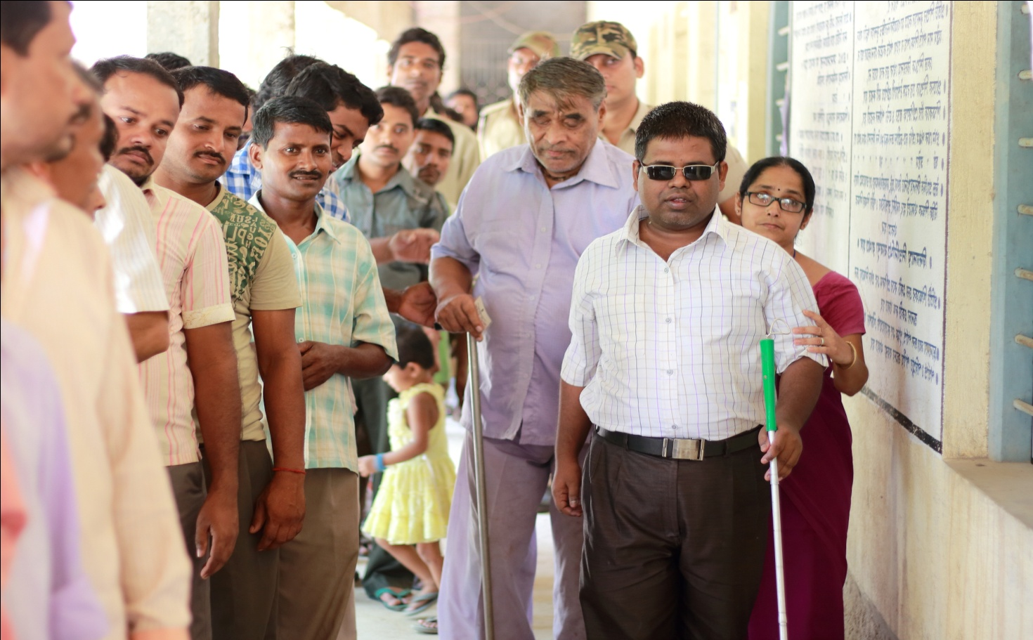
Step 1: Registration
Why don’t people with disabilities get registered as voters?

Slide 17
Registration
Problem 1: Accessibility
Information on registration needs to be accessible
Problem 2: Attitude
Why should persons with disabilities vote anyway?
Problem 3: Stigma and misconception
Persons with disabilities don’t know anything – how will they vote properly?

Slide 18
Identification of PwD electors
Prelim data collected by State with the help of Census, Social Justice and Empowerment Division, Women and Child Welfare Department and Samagra Yojana.
Officers of the Social Justice and Empowerment Department deployed and assigned as and when required as Nodal Officers to ensure the availability of basic facilities to PwDs.
Preparation of PS-wise list of 18+ PwDs at the DEO/ERO/BLO level from the data collected by the concerned departments.

Slide 19
Enrolment
PS-wise list of PwDs indicating the type of disability prepared from the Voters’ List.
Targeted approach to registration of Persons with Disabilities
Inclusion of names of eligible PwDs not listed on ER (during revision programmes),
Involvement of Matadata Shayata Kendras, Voter Assistance Centres, Offices of DEOs, EROs and ROs to facilitate PwD voters.
Adequate instructions to aid in the process of filling of forms at help-centres.

Slide 20
Enrolment – contd.
Checking of Social Welfare Department Scheme Beneficiaries; Visit to Special Care Homes
Door to Door visit by BLOs
Special Focus on registration of mentally challenged persons- emphasis on Unsound Mind certification for non-registrationPartnership with PwD-specific NGOs and CSOs.
Standard template designed by the Commission for collection of data- type of disability and assistance required on the day of poll for PwD voters.
Collection of details of old age homes, senior citizens residing there and enroll the names of eligible senior citizens in the roll- By the District Election Officers.

Slide 21
Outreach and Voter Education
KAP survey has a Section of Qs for PwDs
Voters with disability mapped
Can register online and on mobile as disabled elector and seek requisite assistance
Facilities available given wide publicity to encourage PwDs
Voter Guides in Braille
Special outreach through Civil Society and Celebrities
Notes:
Voters with disability mapped to know their type of disability
Online facilitation and mobile applications to register as disabled elector ; requisite assistance provided at polling booths
Facilities available given wide publicity to encourage PwDs to exercise their franchise
Voter Guides in Braille
Special outreach through Civil Society and Celebrities

Slide 22
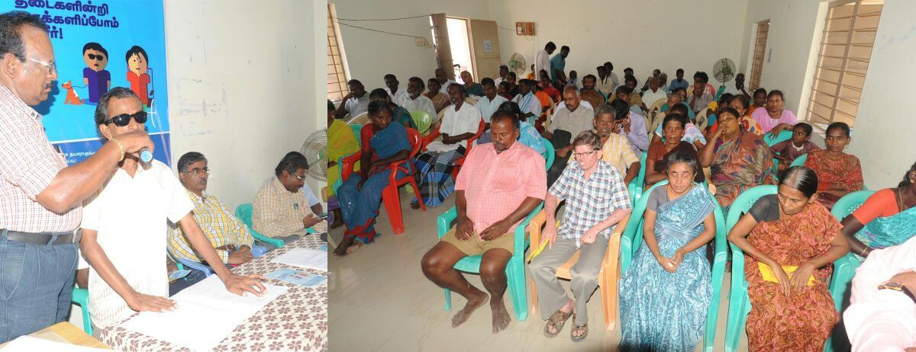
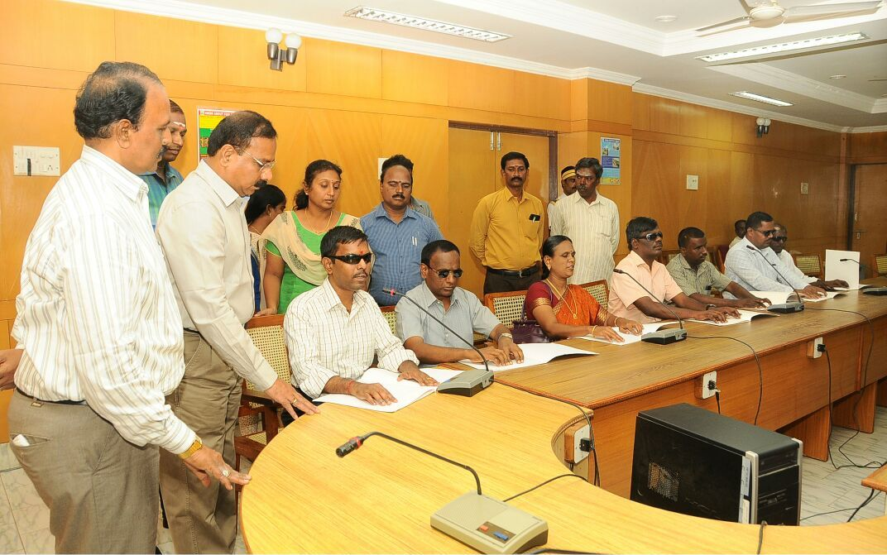
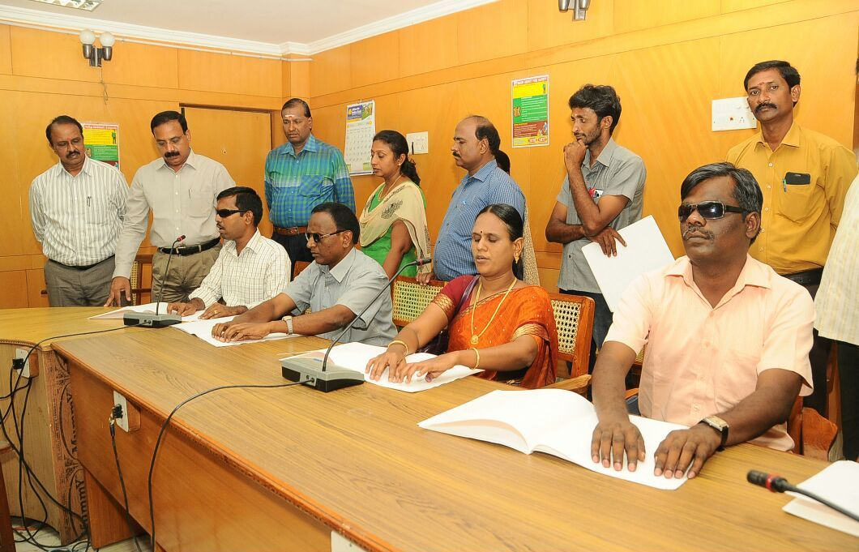
SVEEP for Visually-challenged voters

Slide 23
Outreach and Voter Education
Working with CSOs for greater participation of people with disability
Training on various aspects of disability in all the training sessions.
Training of District and Master trainers
District level sensitization programs for Election officials
Police Officers/Home Guards being specially trained to assist people with special needs outside polling station

Slide 24
Outreach and Voter Education
Do’s and Don’ts being included in all training manual of ROs, Presiding officers, etc
Do’s and Don’ts included in ROs manual
Meeting with all associations of PWD at state level and District level
Training video on all aspects of disabled voting
Officials from Disabled department taken on deputation to coordinate all the activities during elections

Slide 25
Facilitating
Guaranteeing Assured Minimum Facilities (AMF)
What constitutes AMF:
Provision for ramp, drinking water, adequate furniture, proper lighting, proper signage, helpdesk, toilet
How to ensure it?
Preparation of an extensive database of buildings to be used as PS
Review meetings on building facilities done at DEO & CEO Level
Mapping of booths through AMF Maps and then targeted approach was adopted through weekly reviews and Video Conferencing etc.
Feedback taken from political parties.
Wherever permanent infrastructure is not possible, temporary solutions provided

Slide 26



Specifications for AMF
AMF | Specifications
 | Parking for Persons with Disability (PwD) coming on wheelchairs or other vehicles (to be visible from the road) After entrance arrow signs marks indicating the queue Arrow mark indicating the polling personnel Signage for Male/Female toilets Signage for toilets for PwD voters Signage indicating drinking water
 | Tables of 4' x 2 1/2' with provision for 3 people to sit - one BLO with booth slips, two NSS / NSC volunteers (1 male 1 female) to guide and assist the voters (especially the PwDs) entering the polling station
 | Ramps should have an inclination ratio of 1:10 and not more than 1:14 Firm hand rails to be provided which should not be of shaky material In case there are stairs to reach polling station, ramp should also be provided there
Signage
Help Desk
Ramp

Slide 27





Specifications for AMF – contd.
AMF | Specifications
 | Whether separate toilets for Male and Female voters available Whether toilets are PwD-friendly. Whether running water is there in the toilets If running water facility is not there what arrangement has been done?
 | Whether there is facility of drinking water
 | Whether separate entrance and exit is provided in the polling station If no separate entrance and exit is available, whether provision of rope separator/partition can be done? specify
 | Electricity connection with two plug points Minimum 1 fan 2-3 tube lights
 | Is adequate furniture is available? Height of the table on which the Ballot Unit is kept should be disabled-friendly Sufficient moving space around the table for wheel chairs
Toilets
Drinking
Water
Separate
Entry and Exit
Lighting
Furniture

Slide 28
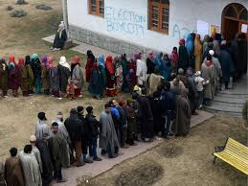
Solutions
Mobile barricades in front of the Doors of each PS
Ramps in front of the door to avoid navigating through corridors
Mobile ramps
Access to ramps, no sandy and slushy pathways

Slide 29
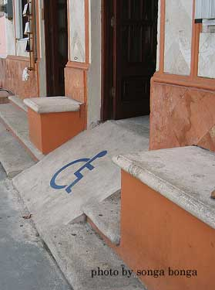
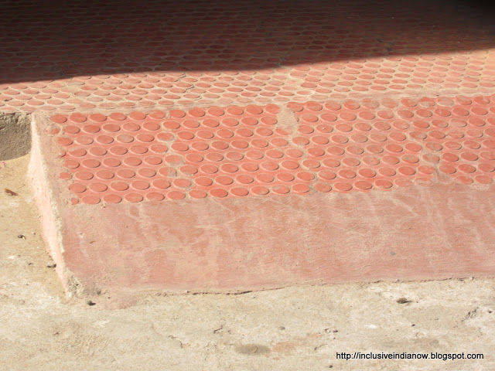
Ramps

Slide 30
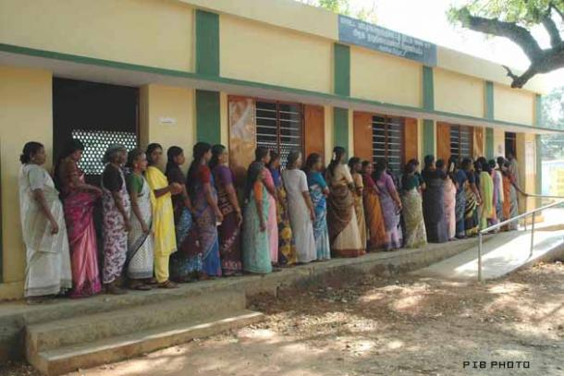
Accessibility of ramps
From Ramps to the door obstructions
Queue on shades
Barricading in front of gates
Only One door barricading for man and women
Audit of all ramps

Slide 31
More Solutions
Wheel chairs in all the urban polling stations
Online booking of wheel chairs at polling stations
SMS facility to mark people as differently abled in electoral roll
Counting of disabled in polling stations
Numbering the braille ballot paper for easy readability by the presiding officer

Slide 32

Signages- Where to go
Bold and Simple
Standard -covering Polling stations , Toilets and water
Inside marking Polling officers etc

Slide 33
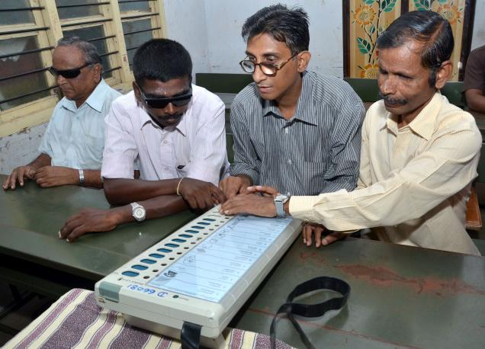
Accessible Voting machines
Table height should not be more than 2.5 feet
Spare chord length to allow movement of ballot machine

Slide 34
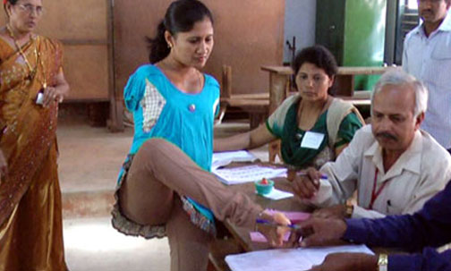
Truly accessible Elections to all!

Slide 35
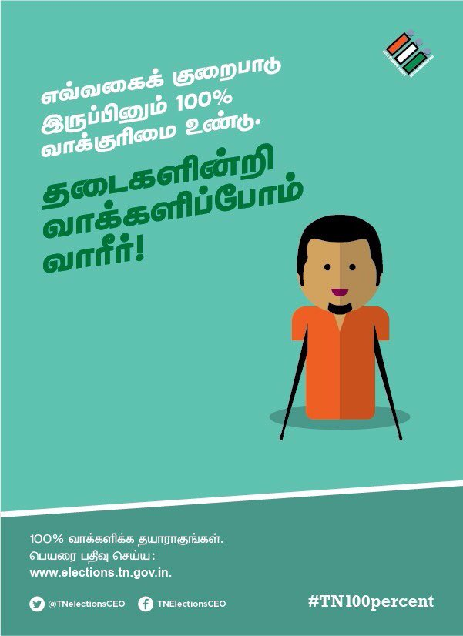
Best Practices (1)
Tamil Nadu–
Special campaign for PwDs
Social Audit of Polling Stations
Accessible website
Tool tips for all the pages, tiles and forms.
Tab index for the entire site.
Browser Titles for the all pages in the site.
Alt text for all the images including forms.
Descriptions in all the labels and buttons.
Audio prompts

Slide 36
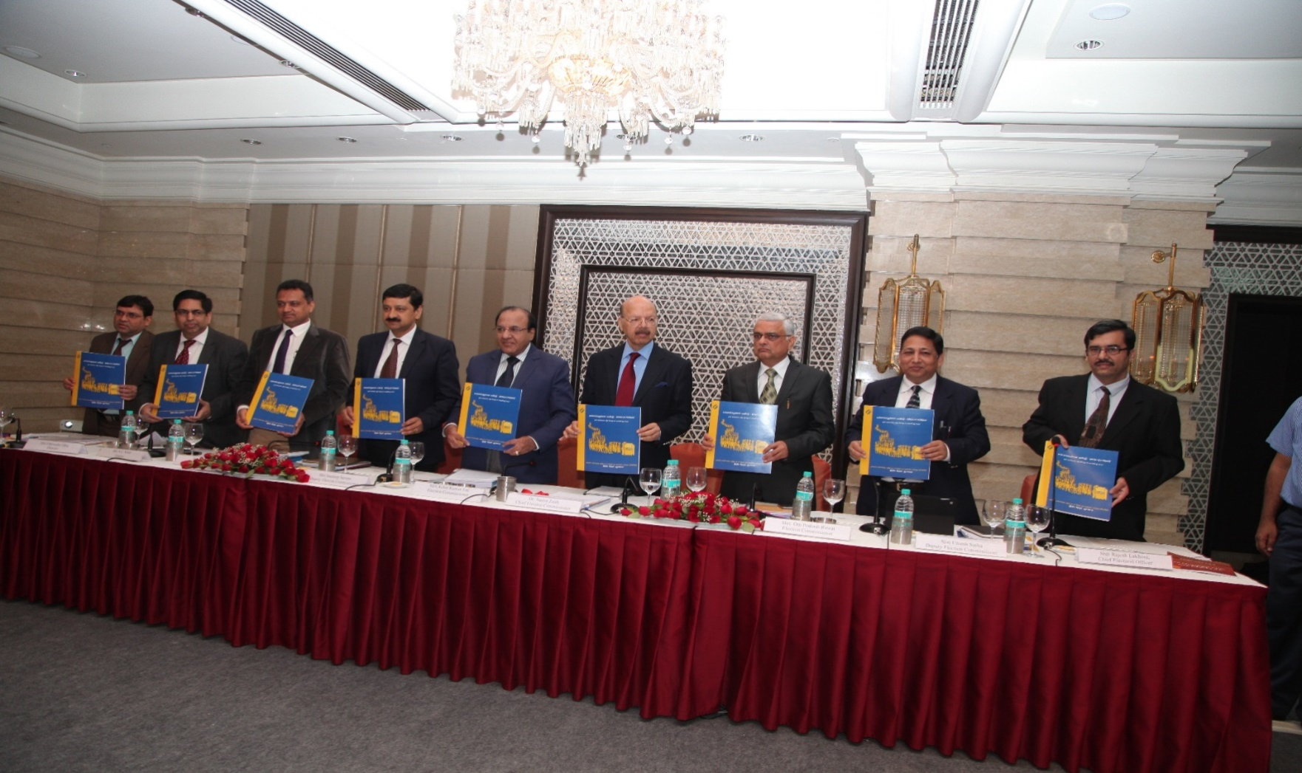
Release of the Guide in Braille during Assembly Election in Tamil Nadu

Slide 37
Checklist for Social Audit of Polling Stations
Checklist for Social Audit – Accessible Elections India
Polling Booth and Voting Process
Selected State : Tamil Nadu | Selected Parliament/ Assembly Constituency | Polling Booth No.
Polling Booth Address | Name of Officer in Charge
Accessibility Audit done by
Date
Sl. No. | Polling Booth Facility / Voting Process Activity | Check / Tick if available | Comments
1 | Approach to Polling Booth Facility
 | Approach road to Polling booth is paved to be accessible with flat / non-skid surface and clear of debris, low hanging objects, trees or poles like obstacles | □
 | Pathway to the Polling booth has necessary curb cuts and ramps in pedestrian / footpath , if crossings available has zebra signs, signals with audio based notice for stop and start pedestrian crossing, to facilitate easy transit from transport vehicles to the Polling booth facility | □
 | Pathway to the Polling booth is marked with large print signs with pictures for Directions to the booth | □

Slide 38
Checklist for Social Audit – contd…
Sl. No. | Polling Booth Facility / Voting Process Activity | Check / Tick if available | Comments
1 | Approach to Polling Booth Facility
 | Approach road to Polling booth is paved to be accessible with flat / non-skid surface and clear of debris, low hanging objects, trees or poles like obstacles | □
 | Pathway to the Polling booth has necessary curb cuts and ramps in pedestrian / footpath , if crossings available has zebra signs, signals with audio based notice for stop and start pedestrian crossing, to facilitate easy transit from transport vehicles to the Polling booth facility | □
 | Pathway to the Polling booth is marked with large print signs with pictures for Directions to the booth | □

Slide 39
Checklist for Social Audit – contd…
Sl. No. | Polling Booth Facility / Voting Process Activity | Check / Tick if available | Comments
2 | Parking and Amenities
 | Reserved Parking facility or a temporary parking arrangement is available for vehicles / wheel chairs of persons with disabilities | □
 | Path from parking facility to Polling booth and back is paved to be accessible with flat / non-skid surface / guiding tactile signs for wheel chair / crutch / non visual users and no obstacles present | □
 | Haphazard parking of vehicles or other obstacles in the parking place is not allowed and monitored to take action for removal | □
 | Accessible Toilet for men / women with grab rails, dry, non-skid flooring, wide enough for wheel chair movement/turning, wash basins in height easy to access through wheel chairs is available for use on requirements | □
 | First aid Kits and Ambulance facilities are available to meet disaster management, emergency requirements and the team in Polling booth are trained or have knowledge on emergency or risk management procedures particularly to assist persons with disabilities, health issues like arthritis or other standing difficulties, elderly persons and pregnant women | □

Slide 40
Checklist for Social Audit – contd…
Sl. No. | Polling Booth Facility / Voting Process Activity | Check / Tick if available | Comments
3 | Access to Polling Booth
 | No hazards or obstacles or partitions or sandy surface or irregular pavement exist or placed temporarily in the path way from entry point of the facility to Polling booth and obstruct free access. If partitions are available for entry and exist, they should be minimum 1 to 1.2 metres width | □
 | Ramps are available and stable to allow wheel chair / crutch / caliper users with a flat and has a gradient of 1: 10 or 1:12, anti-skid pavement and flat surface | □
 | Ramps have grab / guard rails to assist elderly and users with mobility impairments. | □
 | Alternative pathway with ramp if planned, have Universal accessibility Symbol as a sign to mark it as designated way for persons with disabilities, health issues like arthritis or other standing difficulties, elderly persons and pregnant women | □
 | Entrance and doorway to Polling booth has a width of minimum 1 to 1.2 meters pathway for entry / exit of a wheel chair user | □
 | Warning strips and signs in contrast colour to the flooring wherever there is a rise in level or steps in the polling booth | □
 | Volunteers are available in the Polling booth facility to assist on requirements for persons with disabilities, health issues like arthritis or other standing difficulties, elderly persons and pregnant women | □

Slide 41
Checklist for Social Audit – contd……
Sl. No. | Polling Booth Facility / Voting Process Activity | Check / Tick if available
4 | Inside Polling Booth
 | Level across the flooring of the Polling booth to the identification, checking and polling point is flat surface, wide enough for wheel chair movement / turning and has no obstacles for barrier free movement within to finish the voting process by self | □
 | Voting mechanism in Electronic Voting Machine is accessible with braille and large print (18 points and more) information for candidate identification distinctly and sound based response after successful voting | □
 | Voting process instructional guidelines displayed in bilingual (English and Regional Language) or given are in large print, braille for persons with visual impairments and elderly persons
 | Enough visual instructions, directional guidance with pictures are displayed for carrying out the voting process is available in the Polling booth for persons with communication difficulties | □
 | Personal assistance with simple sign language gestures known for those with hearing and speech impairments for carrying out the vote casting is available in the Polling booth | □
 | Adequate lighting facility is available for reading / polling to the elderly and persons with visual impairments. | □

Slide 42
Checklist for Social Audit – contd…
Sl. No. | Polling Booth Facility / Voting Process Activity | Check / Tick if available | Comments
 | The height of the table / counter of the voting machine is at accessible height for accessible wheel chair users / those with lesser height to cast their vote comfortably and in secret / privacy | □
 | Electronic Voting machine in the Polling booth is turned on, tested and in proper working order for casting the vote during the Election day | □
 | Extra seating / resting points in the polling booth are available on requirements or trouble while standing during the voting process for persons with disabilities, health issues like arthritis or other standing difficulties, elderly persons and pregnant woman | □
 | Assistive devices / aids like Wheel chair, Signature guides, rulers, easy to hold large grip marker pens, magnifiers, portable lighting, to aid signing or writing, Augmentative and Alternative Communication (AAC) device or a communication dictionary in context to voting process are available in polling both | □
 | Polling booth officials and agents allow extra time to cast vote, aware of the special needs and provide reasonable accommodations for persons with disabilities and their care givers, persons with health issues like arthritis or other standing difficulties, elderly persons and pregnant woman | □

Slide 43
Best Practices (2)
Delhi –
  provided a separate link on CEO website for registration & request for assistance/facilities on Poll day.
  wheel chairs with dedicated volunteers at all the Polling Stations with the support of Department of Disability Affairs, Ministry of Social Justice & Empowerment.
Jammu & Kashmir, Reasi District –
  launched a mission "Rehbar" for providing ‘home to booth’ services.
  village wise survey & special voters were identified & each assigned one assistant for facilitating movement to & fro polling booth.
  tricycles were hired for 43 polling stations, 21 vehicles used for ferrying differently-abled voters

Slide 44
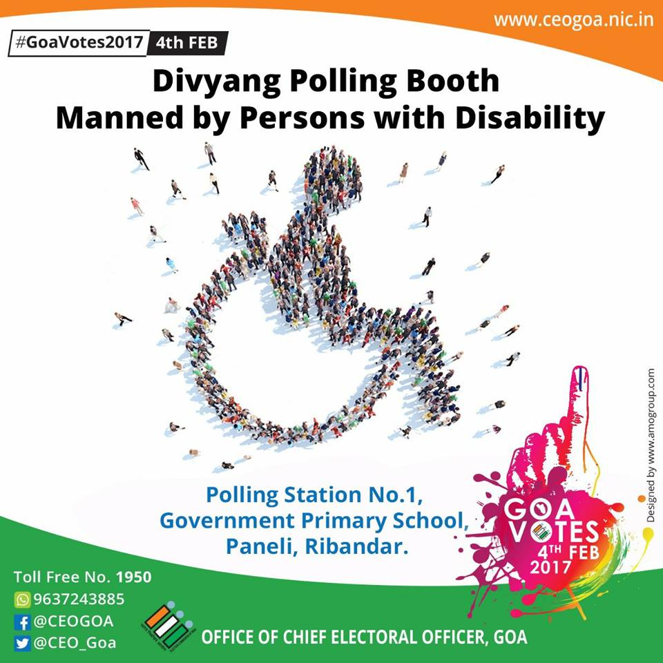
Best Practices (3)
Goa: Divyang Polling Station
One Polling Station to be exclusively manned by Polling Officials falling in category of Persons with Disability.
Affirmative action with positive messaging conveyed to society
Uttarakhand: Divyang Doli
As a helping hand for voters with disabilities who could not walk to the polling station on their own.

Slide 45
Best Practices (4)
Sitapur, UP –
  a digital diary of all specially-abled voters maintained.
  about 3000 PwDs chosen to represent their polling booth & crowned ‘Loktantra-doot’ & given an identity card.
  Loktantra-doot further motivated to turn into emissary for elections by Mr R.P Singh, Cricketer, asking them to ensure 100% voting in their area.
Chandigarh –
  provided pick & drop facility for the handicapped, aged & infirm voters to visit polling station.
  61 persons availed this facility of pick and drop on the day of poll.
Indore, Madhya Pradesh
  special arrangements were made for visually challenged voters. Polling booths provided braille signage for blind voters to enable them to vote.

Slide 46
Best Practices (5)
Cuttack, Odisha –
  single window camps for PwDs were conducted in all the blocks & urban bodies.
  Survey through Anganwadi Workers in October-November 2013 & 20,208 PwDs were enrolled.
  Every PwD voter was contacted on his/her phone & explained the facilities at booths.
  Two volunteers were provided at polling booth to assist.
  Sign language interpreter for the hearing impaired.
  Household contact programme was conducted for 10 days in March- April 2014.
  88.30% of enrolled PwD voted in the district - the highest ever.
Bagalkot, Karnataka
  22,400 differently abled persons – rally & an oath taking ceremony were held.
  They have also asked that their disability card be also used as an identity proof during poll day.

Slide 47
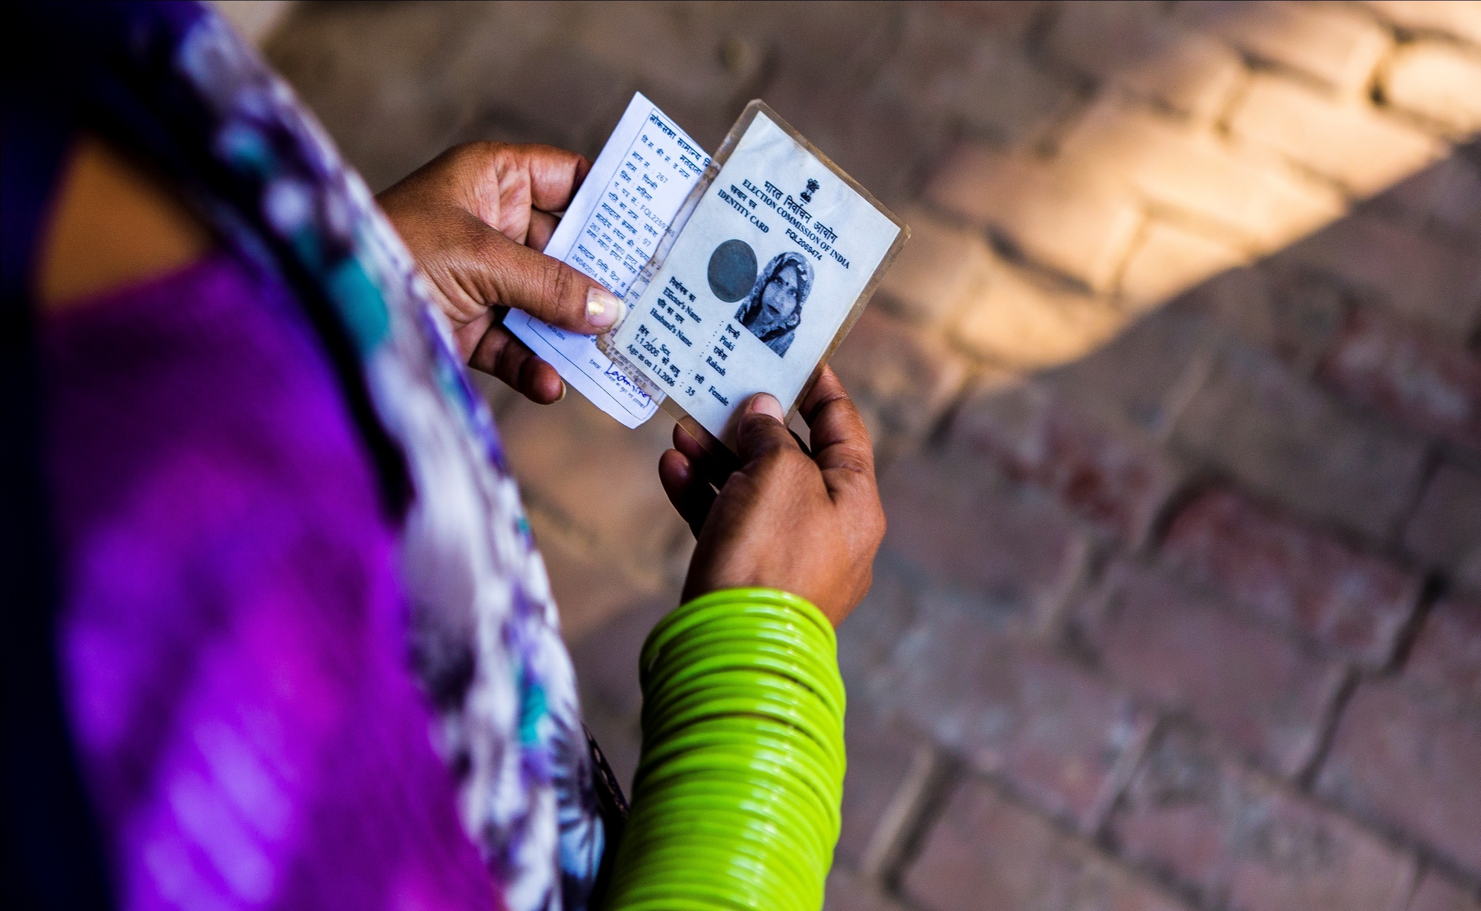
No Voter to be left behind every vote counts

